Slide 1
0-19 Programme Roadshow Presentation

Slide 2
What is the 0-19 Programme?
The radical reshaping of the whole children’s services system with a focus on the core drivers of demand
The biggest transformation programme NELC has seen in recent history
Within any change programme there are always challenges, however...
This is our opportunity to innovate and do things differently and we have to work together to achieve this
Notes:
The 0-19 programme is the biggest transformation programme NELC has seen in recent history. And this workshop for many of you will be your first opportunity to get involved.
We acknowledge it is going to be hard, but to reduce the demand on specialist social care we need to focus on the demand drivers and deliver differently.
We do not want this process to be a “done to” process we need your help to make sure we can make the changes we need “with” you.
We have too many children receiving statutory intervention and staff spend too much time in child protection conferences
There are too many young people being excluded from school and too many of our young people have low skills and are unable to get the local jobs available,

Slide 3
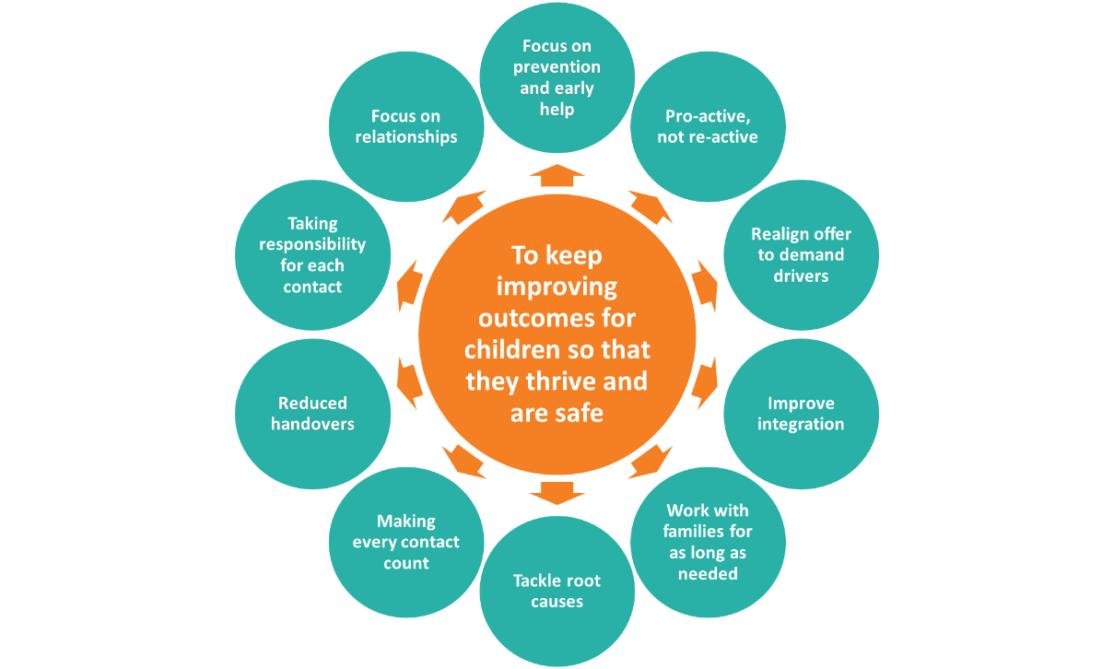
Vision and Principles
Notes:
Members, Councillors and the chief executive are all behind the drive to focus more on prevention and early help.
The principles cover the various features of the intended operating model, for example:
Focus on prevention and early help: making sure all staff understand that by intervening before needs escalate will help limit demand on specialist social care services
Pro-active, not re-active: ensuring the service reaches out to the children and families most in need
Realign offer to demand drivers: focusing support to stop domestic abuse, substance misuse and parental mental health, all which feature in cases where children have become LAC
Improve integration: bringing individual services closer together to share resources and break down siloed working
Work with families for as long as needed: ensuring solutions put in place are sustainable and families become more resilient
Tackle root causes: making sure all interventions are aimed at breaking the cycle of need rather than only dealing with the consequences of need
Making every contact count: making sure there is value added every time a family of young person interacts with the council
Reducing handoffs: bringing consistency to each family in the support they receive from the council
Taking responsibility for each contact: embedding a culture that staff will take responsibility for ensuring families reach the right support, irrespective of where the contact is made
Focus on relationships: understanding that building relationships is critical to persuade families to engage

Slide 4
What Will This Mean
Ensuring all services are aligned to the existing Outcomes Framework
Making sure we can deliver and evidence an overall increase in improved outcomes for children and their families
Having a common performance framework that’s agreed and used across all partners
Developing a wide evidence base to use in the framework
Intelligently responding to the finance challenge
Being clear about how we’ll act to the changing funding structure by 2020, knowing there will be no RSG and the Council will be expected to be self-sufficient
Forming a partnership across the sector due to the similar challenges being faced by other public services, for example cuts to policing budgets
Providing a clear, agreed response to national policy making
Working closer with schools and academies as they understand the expectations in the governments white paper
Considering Central government’s push for new delivery models
Focusing on the ongoing integration with health and social care
Tackling regional devolution and understanding new available funding streams
Being part of the Regional Adoption Agencies (RAAs), Police and Crime Commissioner (PCC) areas and Local Enterprise Partnerships (LEPs), which are often not geographically aligned
Increasing community ownership
Reshaping services as the relationship between citizen and state changes
Working closer with the local voluntary sector
Using local knowledge by further building on the new locality model
Developing and using community assets
To respond to these challenges, we need a fundamental change in how services are imagined, not just delivered
Notes:
The 0-19 transformation will affect everyone in the room and everyone that we work with – we acknowledge it is going to be hard but to reduce the demand on specialist social care we need to focus on the demand drivers and deliver differently.
This process is about transforming models of delivery – this is not a service-centric process – we need to look at the system from the balcony, and not through the lens of existing services

Slide 5
LAC rates have increased significantly over a short space of time
NE Lincs’ LAC population per 10,000 children is higher than the England average and rose to become in line with statistical neighbours in 2014 following an OFSTED inspection. LAC rose by 68% from 2012 to 2014. This increased rate reflects a changed approach to risk. Recent changes are showing signs of success, with LAC numbers stabilising in 2015.
Whilst LAC rates appear in line with statistical neighbours, evidence from case reviews suggests a significant proportion could have been avoided if there was improved multi-agency prevention in place
Notes:
There has been a further rise in LAC numbers to just over 80 per 10,000 children in 2016
The results of the analysis are very interesting although maybe not surprising. We have seen a significant increase in the number of children becoming looked after in a relatively short space of time. LAC rose by 68% from 2012 to 2014.
The number of looked after children has recently began to stabilise as a result of the improvements made in the last few years but there is much more still to do.

Slide 6
There is strong evidence of avoidable demand in the system
Case Reviews
Partner Survey
Benchmarking Data
For each looked after child’s case reviewed, the reviewer was asked: in your professional opinion, could taking this child into care have been prevented through the provision of more timely, earlier help and support?
Partners were asked to estimate the % of children they could have avoided referring to early help or social care, had more been done around early intervention and prevention.
The rate of looked after children under-18 per 10,000 population has increased from 45 in 2012 to 77 in 2015. NE Lincs previously had lower rates than statistical neighbours, but this rate is now in line with the average (comparators include Hartlepool, Doncaster and Rotherham).
Both CiN and CPP populations have significantly increased over the last 3-4 years and now exceed rates seen both nationally and in statistical neighbours.
These increases in rates are not accompanied by an underlying change in demographic.
44% of partners believe that referrals could be avoided if more effective and timely help and support was provided to families.
51% of cases could have / possibly been prevented from becoming LAC
Notes:
We are beginning to see a reduction in CIN and CP numbers but the LAC rate has yet to show signs of reduction
There is a lot of evidence that suggests there is avoidable demand in the system.
Case reviews revealed that around half of LAC could possibly have been prevented by more effective and timely prevention and early help
Partner surveys revealed that 44% of partners believed referrals to social care could have been prevented if there was more effective prevention and early help

Slide 7
And this can be seen at various flow points in social care
The progression of cases through the early help and social care system shows that there is a high number of cases which are not fully progressing through the system, suggesting wasted effort, time and money:
Only 47% of contacts progress to referral
75% of referrals progress to assessment and only 56% of assessment progress to social care
Only a small proportion of contacts from early help progress to referral
A large number of cases jump steps in the contact, referral and assessment process
In the period March 15 – Feb 16 51 of the 184 children that became looked after had no previous social care involvement
Includes 295 cases with no recorded previous social care involvement
There are areas where children and families could be receiving support earlier through early help
We need clearer pathways and feedback on referrals and local services
Notes:
An assessment of contact, referral and assessment behaviour suggests there is wasted effort in the system.
In the period March 15 to Feb 16:
Only 47% of contacts progress to referral
75% of referrals progress to assessment and only 56% of assessment progress to social care
Only a small proportion of contacts from early help progress to referral
A large number of cases jump steps in the contact, referral and assessment process
51 of the 184 children that became looked after had no previous social care involvement (28%)
This suggests that pathways need to be clearer and we need to look at referral behaviours as well as look at how we identify families in need of support

Slide 8
Part of this is because we aren’t responding effectively enough to the core drivers of demand – individually or collectively
There is a high percentage of children who had one of the toxic trio factors present (Domestic Abuse, Mental Health, Substance Misuse in the home or family) as a cause of their becoming LAC. Over 75% of cases have at least one of the so called “toxic trio” as a root cause.
Domestic Abuse
All of these issues affect key partners in NE Lincs: high domestic abuse increases police call outs, hospital admissions, worsens mental health & makes attainment harder to achieve
Notes:
Looking at the case studies it is clear that there are 3 core drivers of demand which are DA, Substance Misuse and Parental Mental Health. Over 75% of cases studied had at least one of these 3 factors within the home or family.

Slide 9
Or focusing on the right age cohorts
There is a high number of children becoming LAC before their 1st birthday.
Of overall LAC:
29% of LAC are from families with 4 or more children;
56% are male vs. 44% female; and
95% of children in care are white British.
There are particularly high numbers of children coming into care before their first birthday
It appears specific focus on this age group – and the pathways between health and children’s services are needed across the local area
Notes:
The age of children entering care also tells a story, the highest numbers entering the care system are under the age of 1y. There is also a spike around the age of 15. This shows the importance of the pathways between health and children’s services.

Slide 10
We need to use our data as intelligence to target resources
163 children aged under 1 have become looked after in the last 3 years
135 of those under 1s have siblings
107 of those under 1s have siblings who have also been LAC
56 of the under 1s have siblings who also became looked after before their 1st birthday
There are a high number of children becoming looked after before their 1st birthday.
The 163 U1s who became looked after in the last 3 years have in total 281 siblings.
126 of the 281 siblings (45%) have also been LAC.
The 163 U1 are shared between 137 mothers
15% of these 137 mothers have themselves been looked after children.
Grouping further, gives a cohort of 37 mothers who have between them have had 81 Under 1s removed.
The group of 37 mothers
predominantly live in the most deprived areas
Are more commonly referred by individuals
Children most commonly present with neglect or physical abuse
There are small number of mothers who have been looked after & who are having multiple children removed. We need a more integrated & impactful pathway particularly between health & children’s services
Notes:
Taking a closer look at the under 1’s:
The 163 U1s who became looked after in the last 3 years have in total 281 siblings.
126 of the 281 siblings (45%) have also been LAC.
The 163 U1 are shared between 137 mothers
15% of these 137 mothers have themselves been looked after children.
Grouping further, gives a cohort of 37 mothers who have between them have had 81 Under 1s removed.

Slide 11
And make pathways and terminology clearer to partners
The partner survey highlighted some uncertainty around both pathways and terminology.
37.5% disagree
24% of partners believe the best way to access early help is through a social care referral
57.3% disagree
20% of partners believe that referrals to social care improve the speed at which services are received by families
51.7% disagree
62% of partners believe that if they are uncertain about referral criteria its safer for the child if they refer direct to social care.
Improved clarity of pathways is needed across the early help system.
Notes:
Change terminology throughout to social care
Prof Eileen Munro explained that ‘the responsibility has been handed to social workers because we haven’t expressed clearly enough what is a reasonable level of managing uncertainty.’ This is something we need to get right across the whole system, so families are not unnecessarily referred on but rather supported as soon as a need arises.
We need to make pathways and terminology clearer to partners. The partner survey has highlighted some uncertainty around pathways and terminology.
24% of partners believe the best way to access early help is through a social care referral
20% of partners believe that referrals to social care improve the speed at which services are received by families
62% of partners believe that if they are uncertain about referral criteria its safer for the child if they refer direct to social care

Slide 12
Key Findings
The range of work iMPOWER has supported the Council with has identified avoidable demand in the system, which is partly driven by staff and partner behaviours. From the work, there are six key findings:
Finding 1: There is avoidable demand in the system, which is partly driven by referral and assessment behaviours
Finding 2: Services need to be more effective and better aligned to the drivers of demand
Finding 3: Families who are hard to reach, or most at risk, are not always targeted
Finding 4: Improved communications with staff and partners could help to improve understanding of the system and give clarity over responsibilities
Finding 5: Staff and partners understand the value of early help and are motivated by improving outcomes
Finding 6: Services are disjointed and need to be more integrated (there is evidence of duplication and gaps in the system)
Notes:
Finding 1: There is avoidable demand in the system, which is partly driven by referral and assessment behaviours
Finding 2: Services need to be more effective and better aligned to the drivers of demand
Finding 3: Families who are hard to reach, or most at risk, are not always targeted
Finding 4: Improved communications with staff and partners could help to improve understanding of the system and give clarity over responsibilities
Finding 5: Staff and partners understand the value of early help and are motivated by improving outcomes
Finding 6: Services are disjointed and need to be more integrated (there is evidence of duplication and gaps in the system)

Slide 13
0-19 Programme on a Page
£
NE Lincs wants to improve outcomes for children and their families
The sector is facing significant financial pressure
Demand for social care has increased and needs to be reduced
Opportunities
What does the programme need to do?
Evidence shows there is some avoidable demand in the system
There is a high prevention spend which could be better aligned to the drivers of demand; DA, SM & MH
Hard to reach and families most at risk are not always targeted
Improved comms with partners could help to improve understanding of the system and give clarity over responsibilities
Staff are motivated by improving outcomes and are up for the change
Partners agree improved EH is the way forward
Sustainably rebalance children’s services by focusing on prevention and reducing demand to social care
Integrate services (in consultation with partners) to maximise impact
Target cross sector resources to tackle root causes of demand
Simplify pathways (particularly for universal services)
Measure impact at strategic and local levels
CAPACITY & PACE ARE KEY RISKS. THE PROGRAMME NEEDS TO BE WELL SEQUENCED.
Notes:
51% of LAC could have been prevented
8% of LAC had an early help assessment
This in a nutshell is the 0-19 programme on one page.
In summary:
NE Lincs wants to improve outcomes for children and their families
The sector is facing significant financial pressure
The demand for social care has increased and needs to reduce
But we have opportunities:
There is avoidable demand in the system
The most hard to reach families are not always targeted
Our staff survey resulted in a high number of our staff being classified as “pioneers” that are motivated by improving outcomes and are up for change
Partners agree that prevention and early help is the way forwards
Spend can be better aligned to drivers of demand and there is the opportunity to improve communication with partners and simplify pathways
As a result the programme needs to:
Rebalance our services by focusing on prevention and aligning our offer to the drivers of demand
Integrate services more
Simplify pathways
Focus cross-sector resource on the root causes of demand
Measure impact

Slide 14
What does the analysis suggest the programme needs to achieve?
The system need to become more integrated
Model of delivery needs to change
We need to work with some families for longer
The system needs more direct delivery and intervention
The skills of the workforce need to develop
The area needs to invest in partnerships
We need to use data differently
There is a need to commission different specialist support
A consistent and valued input from partners is needed in the programme to ensure it properly responds to their views and needs
Notes:
The system need to become more integrated and the model of delivery needs to change
There is a need to work with some families for longer to support sustainable change and resilience in families across North East Lincolnshire
The system needs more direct delivery and intervention rather than repeat assessments and referrals to others
The skills of the workforce need to develop – so all staff across all agencies have core skills in:
Identifying and responding to domestic abuse
Identifying and responding to substance misuse
Low level emotional health support
Assertiveness and persistence with hard to reach families
The area needs to invest in partnerships – not just through board meetings but through one-to-one relationships to build shared value around the programme
We need to use data differently to both measure impact and to target shared resources at particular communities and cohorts – becoming more pro-active not reactive
There is a need to commission different specialist support services around core issues that drive future demand

Slide 15
How will we measure success?
The key success measures identified for this programme are:
Effective and targeted early help
An effective and efficient front door
Reduced demand on specialist social care services
Targeted and appropriate allocation of placements
These elements will be evidenced by:
Safe reductions in the number of looked after children
Safe reductions in the number of children on child protection plans
Safe reductions in the number of children in need
Reduced number of referrals resulting in no further action
Reduced number of assessments completed by social workers
Evidence of successful interventions undertaken (reporting on impact, not process)
Reduced numbers of children in residential placements and seek to minimise placements with independent foster agencies.
Notes:
The key success measures identified for this programme are:
Effective and targeted early help
An effective and efficient front door
Reduced demand on specialist social care services
Targeted and appropriate allocation of placements
These elements will be evidenced by:
Safe reductions in the number of looked after children
Safe reductions in the number of children on child protection plans
Safe reductions in the number of children in need
Reduced number of referrals resulting in no further action
Reduced number of assessments completed by social workers
Evidence of successful interventions undertaken (reporting on impact, not process)
Reduced numbers of children in residential placements and seek to minimise placements with independent foster agencies.

Slide 16
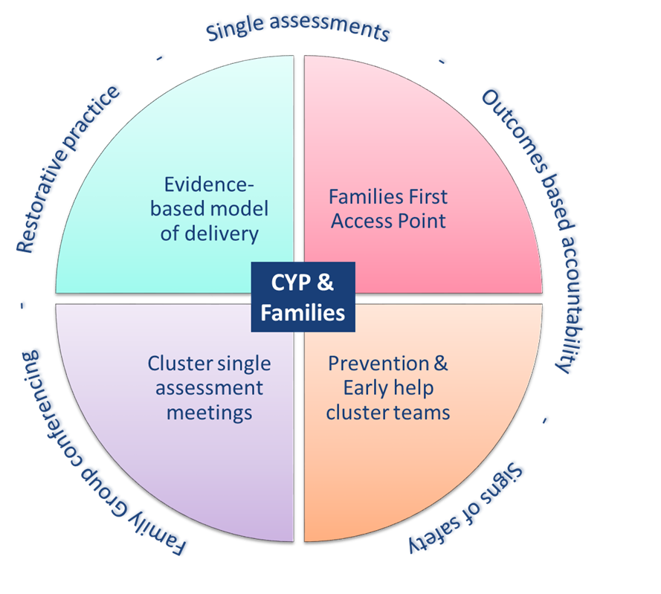
Building on Work to Date The programme will build on the successful models of practice in place in NE Lincs, in particular, the work developed by the creating stronger communities and prevention and early help projects. These ways of working will provide the cornerstones of practice for the new model.
Notes:
Professor Eileen Munro eloquently explains that our job isn’t about writing beautiful reports ... It is to make life different for children and we have a good foundation on which to build
FGC, restorative practice, SA and signs of safety and OBA – we know these are beginning to effect change and these will continue
We are not beginning from a standing start. We have some cornerstones on which we can build. These are:
FGC
Restorative practice
Single Assessment and Signs of Safety
Outcomes Based Accoutability
We need to further build on the idea of clusters, and cluster partnerships, evidence based models of delivery and ensuring the front door to services is accessible.

Slide 17
Phasing the redesign
Understand our demand & opportunities to reduce
Engage with staff & partners on what we find
Re-design & integrate services – starting with ‘Early Help’
Consult on changes & implement new model
Analyse impact & track progress
There are four key pathways we will be re-designing & improving as part of the programme. These include:
Phase 1 - Prevention and Early Help
Phase 2 - Social Care
Phase 3 - Emotional & Mental Health
Phase 4 - Education and SEN (D)
We need to phase our activity with the intention of starting with ‘early help’ to support reductions in future demand
A central part of all of these phases will be our links to schools to drive attendance & attainment, with a key ambition of better wrapping support around local schools & utilising the support they have within them
Notes:
This is 5 months into a 3 year programme. All phases are interrelated as the work we undertake is never linear
The programme will follow a commissioning cycle approach and in turn consider the 4 key pathways in children’s services starting with prevention and early help.
Later phases include Social Care, Emotional and Mental Health and Education and SEND

Slide 18
Next Steps
Continue to take the messages out to any partners/groups who have a role to play
Input into redesign of services welcomed
Need to see a whole place approach
Aiming for proposed basics of redesign by the end of January

Slide 19
0-19 Programme
East Marsh and West Marsh Prototype Proposals and Initial Ideas

Slide 20
Initial Model Thoughts
Oversight Function
Linked Team
Linked Team
Linked Team
Linked Team
Linked Team
Partially Integrated Prototype Team
Fully Integrated West Marsh Team
Fully Integrated East Marsh Team

Slide 21
Full Integration Proposal
Initial thoughts based on current staff groups in the West Marsh Area:
West Marsh Early Intervention Policing Team
Family Hub Staff (those currently based in cluster 3)
Integrated Family Services Staff (those currently based in cluster 3)
Health Visiting Team (West Marsh HV team)
School Nursing Team (West Marsh Schools’ Nurses)
Youth Offending Pre-Court Staff – (a number of dedicated staff)
Young People’s Support Service Staff – (a number of dedicated staff)
Notes:
We need to consider how the oversight of this will be undertaken – each team has a manager – need one to have oversight – do we offer this out as an opportunity on top of the day job?

Slide 22
Offers so far...
Policing EI team
NSPCC
Policing evaluation team
The Equality Practice
Internal teams

Slide 23
We would welcome your view on the challenges and opportunities
of the programme
lisa.smith@nelincs.gov.uk mary.marsh@nelincs.gov.uk pip.harrison@nelincs.gov.uk

