Slide 1
Humber Coast and Vale Sustainability and Transformation Plan November 2016

Slide 2
Contents
Section | Page Number
Our Vision | 3
Our Footprint | 7
Case for Change | 9
STP Programme Structure | 12
Workstreams | 13
Our Roadmap | 17
Enabling the Change | 18
Communication and Engagement | 19
Finance | 20
System Governance | 22

Slide 3
Our Vision for Humber, Coast and Vale
Our vision for 2021 is for healthy communities with supporting care systems that enable people to start well, live well and age well.
We want to put arrangements in place that:
Support everyone to manage their own care better
Reduce dependence on hospitals
Enables service resources to be used more effectively and efficiently
Our triple aim is to improve:
Health and wellbeing
Quality of Care
Efficiency.

Slide 4
Our Vision for Humber, Coast and Vale
We want people in who live in our community to say:
I understand there are better
alternatives than using my local
A&E for urgent care
I only go into hospital when it is planned and necessary
I know how to look after myself to reduce the chance of falling ill
I know how to look after myself to reduce the chance of falling ill
I have 24/7 access to an on call
primary care practitioner, or
appropriate practitioner to meet
my urgent care needs
I receive a consistent, excellent quality of treatment from all health and care organisations in across the patch

Slide 5
Changing Attitudes and Perceptions
Acute and Specialised Care
Primary and Community Care
Enhanced and Integrated Primary and Community Care
Prevention and Self Care
Acute and
Specialised Care
Prevention and
Self Care

Slide 6
Changing the Focus
From a hospital focused system
To a person centred system
People
Prevention and Self Care
Integrated & Enhanced Primary, Community and Social Care
Hospital
Community Care
General Practice
Nursing Homes
Community Hospitals
Out of Hours
111
Voluntary Sector
Acute and Specialised Care
From this…
to this…

Slide 7
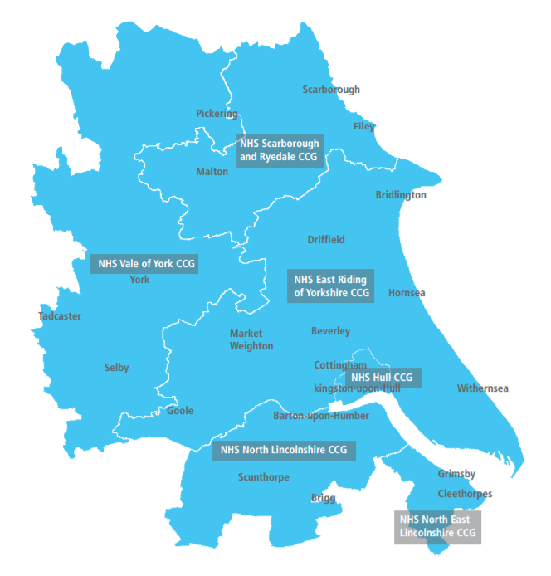
Our STP Footprint

Slide 8
Our STP Footprint - Organisations Involved
6 CCGs
3 Acute Trusts
3 Mental Health Trusts
6 Local Authorities
2 Ambulance Trusts
Community Service Providers
Other Stakeholder Organisations

Slide 9
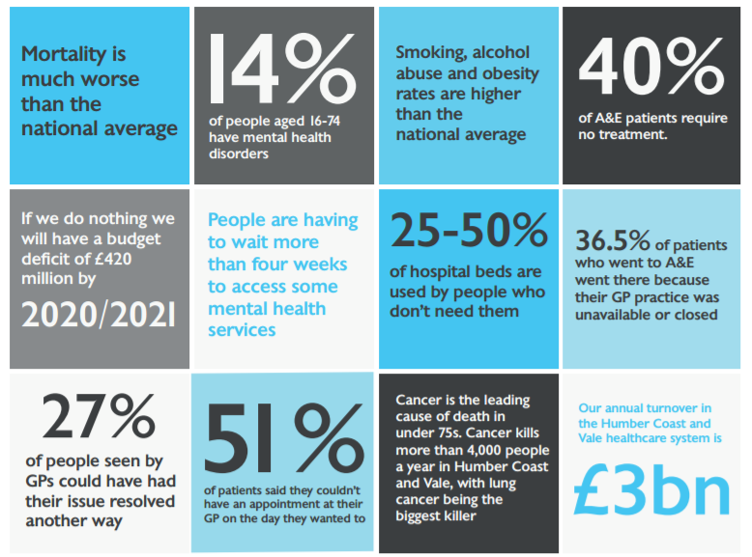
Our Case for Change

Slide 10
Triple Aims – Our Challenges
Health and Wellbeing | Mortality – Standardised mortality is significantly worse than the national average. On average the death rate of under 75s is 153 per 100,000. Prevention – Smoking, alcohol abuse and obesity rates are higher than the national average. Cancer – Cancer is the leading cause of death in under 75s. Cancer kills over 4,000 people a year in the HCV patch, with lung cancer being the biggest contributor.
Quality of Care | The Right Care – 40% of A&E patients require no treatment. 25-50% of hospital beds are used by people who don’t need to be there. The Right Place – 27% of people seen by GPs could have had their issue resolved another way. 36.5% of A&E patients went there because the GP practice was unavailable or closed. The Right Time – Citizens will wait over 4 weeks for to access some mental health services.
Efficiency | Deficit – If we do nothing as a STP footprint, will be in a deficit of £420 million by 2021.

Slide 11
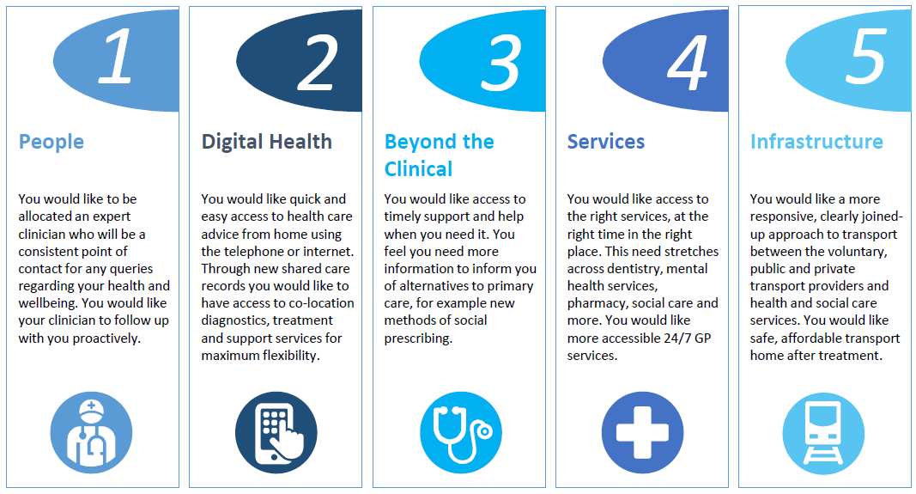
What Are People Telling Us
We have engaged with more than 30,000 people over the past three years. Five key themes have emerged:

Slide 12
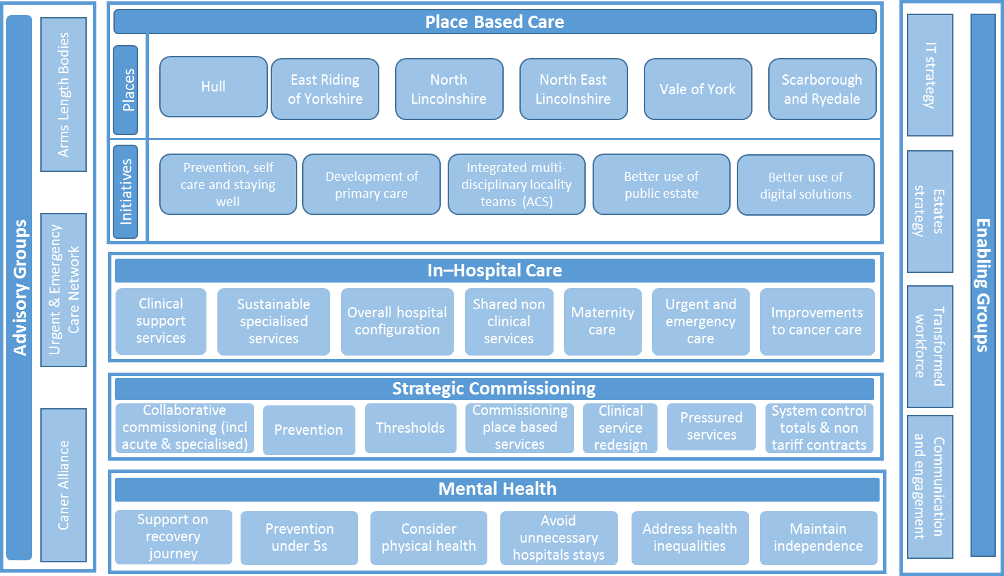
STP Programme Structure

Slide 13
Place Based Priorities
1 - Prevention, Self Care and Staying Well
Supporting people to stop smoking to reduce lung cancer
Identify and act early on Cancer
Preventing Cardiovascular Disease and Diabetes
Prevention at scale e.g tackling falls, obesity, physical activity alcohol misuse, prescription medicine misuse and care navigation
Develop a single electronic care record which can be shared and accessed by all health care professionals
Develop an information hub for citizens to access their health records
Update infrastructure and IT equipment to enable more staff to deliver mobile care
2 - Better Use of Digital Solutions
We will continue to identify and value the opportunities to reduce the estate and land that we currently hold and use space better in our ‘places’
4 - Integrated Multi Disciplinary Local Teams
5 - Better Use of Public Estate
3 - Development of Primary Care
Teams will join up local services to coordinate and deliver as much care as possible locally so people only have to go to hospital if required
Improve access to GPs and other primary care clinicians through implementation of the GP Forward view programme.

Slide 14
Delivering Service Improvements
Create formal clinical networks for Cancer, Major Trauma, Vascular and Critical Care
Review complex rehabilitation services, paediatrics, neonatal intensive care and specialised orthopaedics
2 - Improvement to Cancer Care
3 - Maternity Care
1- Sustainable Specialised Services
Create smarter cancer diagnostics
Create consistent recovery packages
Better support for people living with and beyond cancer
Improve local maternity systems to reduce stillbirth and neonatal death rates and improve perinatal mental health
4 - Shared Non-Clinical Services
Standardise what we do and share scarce resource to provide better and more efficient services
7 - Urgent and Emergency Care
Create a consistent quality of care, 24 hours a day for people who have emergency and specialist emergency care needs,
Improve supported self care and advice using digital technology
Establish a Clinical Advisory Service
Standardised quality and patient experience across departments. Initial focus will be on dermatology, Ophthalmology, Orthopaedics, Orthodontics and Maxillo-Facial.
5 - Clinical Support Services
6 - Overall Hospital Configuration
Elective services
Non elective services
Ambulatory services

Slide 15
Strategic Commissioning
1 - System Control Totals and Non Tariff Contracts
2 - Commissioning Place Based Services
3 - Thresholds
Develop a financial system that focuses on the outcomes that matter to people rather than the current payment by results contract
New multi-disciplinary locality teams need to be commissioned to provide services that meet the individual needs of local communities
Implement evidence based service thresholds consistently across the HCV footprint
4 - Collaborative Commissioning
Clinical Service Redesign
Pressured Services
Move to strategic commissioning across HCV, adopting an asset based approach with a focus on prevention, well being, self care and delivering outcomes that matter for patients
Evidence based redesign of services across the HCV footprint
Develop a HCV wide approach to those service areas that are pressured to channel resource in a way that will generate the best outcomes for our patients

Slide 16
Mental Health Priorities
3 - Provide Services Which Maintain Independence
Treatment in the community will become a default option
Addressing existing gaps in onward placements and services
2 - Avoid Unnecessary Hospital Stays
Address the independence of those with dementia
1 - Support on Recovery Journey
Develop more non clinical services, ensuring that extended assessment is available for all
Ensure that we have 24/7 intensive home based alternatives to admission and effective 24/7 urgent & emergency liaison mental health services for all ages
4 - Address Health Inequalities
6 - Consider Physical Health
Invest in evidence based practice, informed by lived experience to commission services designed to achieve comparable outcomes for all
Propose new pathways and prescribing guidelines which address the known potential impact of some mental health medications on physical health
5 - Prevention Under 5s
Focus on bonding and attachment delivered through health visitors, schools and parenting support

Slide 17
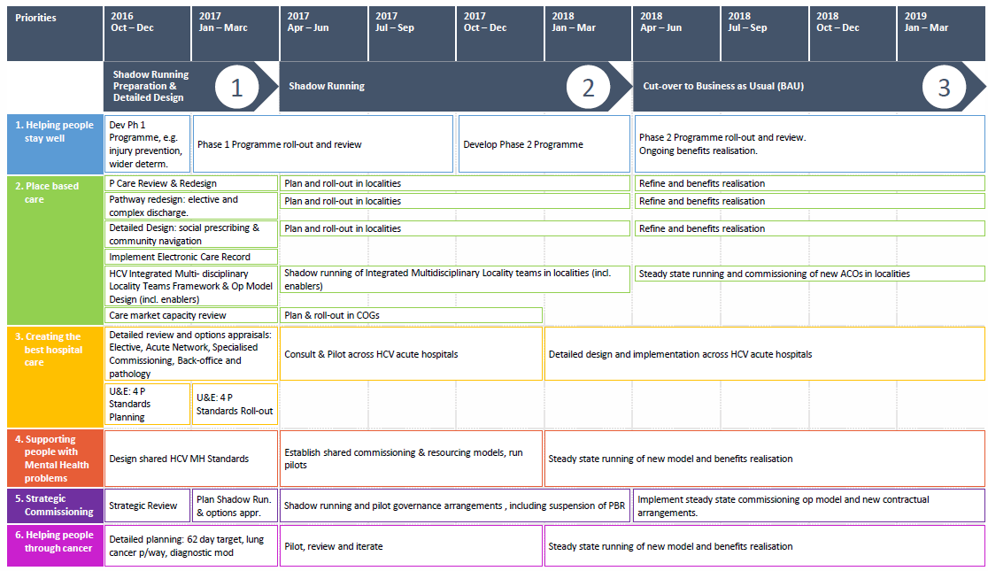
Our Delivery Roadmap

Slide 18
Enabling the Change
To address shortages of skills and to help make sure doctors focus their time on the things that no one else can do we are implementing two training programmes;
Support Staff at scale
Advanced Practice at scale.
We will use the estate we have to support delivery of our priorities.
E.G. providing care closer to home means we need to make best use of the estate in our localities.
We will make sure each of our big ideas are shaped through engagement with key stakeholder groups such as;
Public
Patients
Staff
Other stakeholders.
We will utilise technology to;
Give patients access to more information to help manage their own health
Create a single electronic care record so patients should only be asked things once
Transformed Workforce
Communication and Engagement
Estates Strategy
IT Strategy

Slide 19
Communication and Engagement
Our activities under the STP will, wherever possible, use the vehicles of locally established programmes including Healthy Lives, Healthy Futures and Ambition for Health.
We have engaged with more than 30,000 people across:
patient groups,
the voluntary sector,
hospitals,
GPs,
local councils,
commissioners of services
We plan to continue to engage and consult with:
Health and Wellbeing boards
Service users and the wider public
Staff, including clinicians.

Slide 20
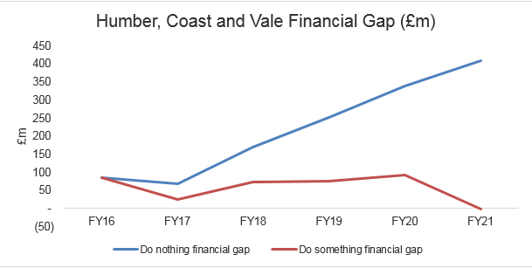
Finance – what if we do nothing?
If we ‘do nothing’ we will have a £420m funding gap by 2021

Slide 21
Finance – Closing the Projected Gap
The bridge diagram below outlines the estimated contribution each area will make to closing the projected financial gap

Slide 22
System Governance
The STP is a partnership, not a statutory body. Governance arrangements are currently built around the Strategic Partnership Board and the STP Executive Group.
Primary Care 5 year Forward View Group
Strategic Partnership Board
H&WB Boards
Clinical Advisory Group
Strategic
Prevention and self care
Executive Group
Finance Technical Group
Quality Assurance Group
Delivery Group
Worksteam & Place Delivery Groups
Hull
East Riding of Yorkshire
North Lincolnshire
Vale of York
Scarborough and Ryedale
In – Hospital care
Mental Health
Strategic Commissioning
North East Lincolnshire
Place based care
Delivery Focus
Enabling Groups
Local Workforce Action Board
IT Strategy
Estate Strategy
Communication and engagement

