Slide 1
“Ageing Well in North East Lincolnshire” Director of Public Health Annual Report 2016

Slide 3
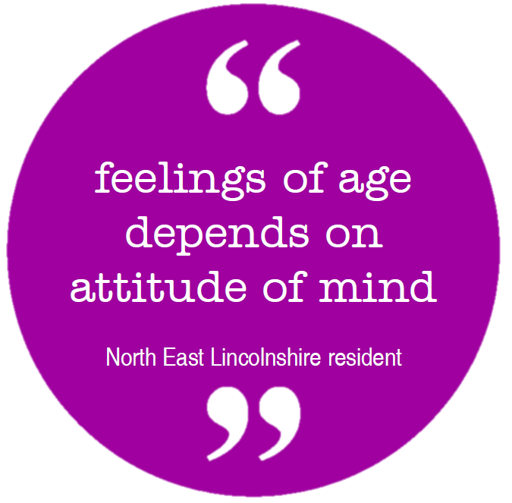
Older People
What does old mean?
Different for different people;
biological and calendar ages
Pension age is 65, but rising due to
increased life expectancy and changes in culture
Our survey found...
on average people thought old age began at 69.

Slide 4
How many older people are there?
A fifth of NEL population is aged 65+
NEL has an ageing population; greater than national figures
Source: ONS

Slide 5
Population projections
Older populations are increasing
The number of people aged 85+ is predicted to nearly double by 2037
Source: ONS

Slide 6
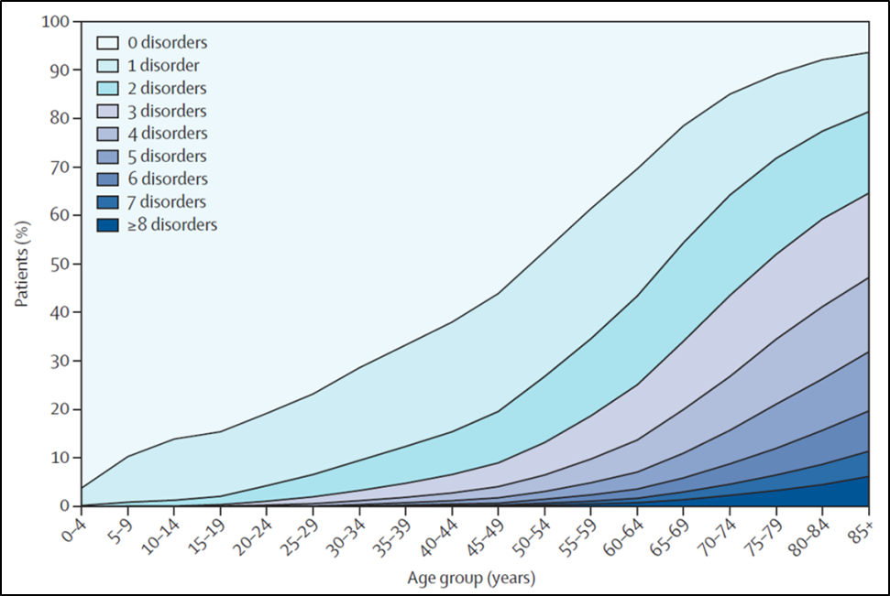
The implications of an ageing population
Increasing age and survival increases the potential for cumulative numbers of long-term conditions (see figure below).
Multi-morbidity is associated with age and deprivation, therefore, it is a major public health issue for North East Lincolnshire due to the ageing population and high levels of deprivation across the area.
Source: Barnett et al., 2012
Older people are on the whole, are fit and healthy and do bring many benefits to the area, such as volunteer work across a wide range of activities.

Slide 7
Life expectancy
Life expectancy in North East Lincolnshire is 80.3 years, with the East Marsh, South and Sidney Sussex wards having the lowest life expectancy.
Females life expectancy is 82 years which is slightly greater than males which is 78 years.
Source: ONS

Slide 8
Healthy Life Expectancy
In NEL the healthy life expectancy in males is 61.4 and for females 63 years, both are significantly lower than England.
Source: ONS

Slide 9
Disability Free Life Expectancy
Disability free life expectancy for NEL for 2009-2013 is 62.3 for males and for females it is 63.9 years both of which are significantly lower than England.
Source: ONS

Slide 10
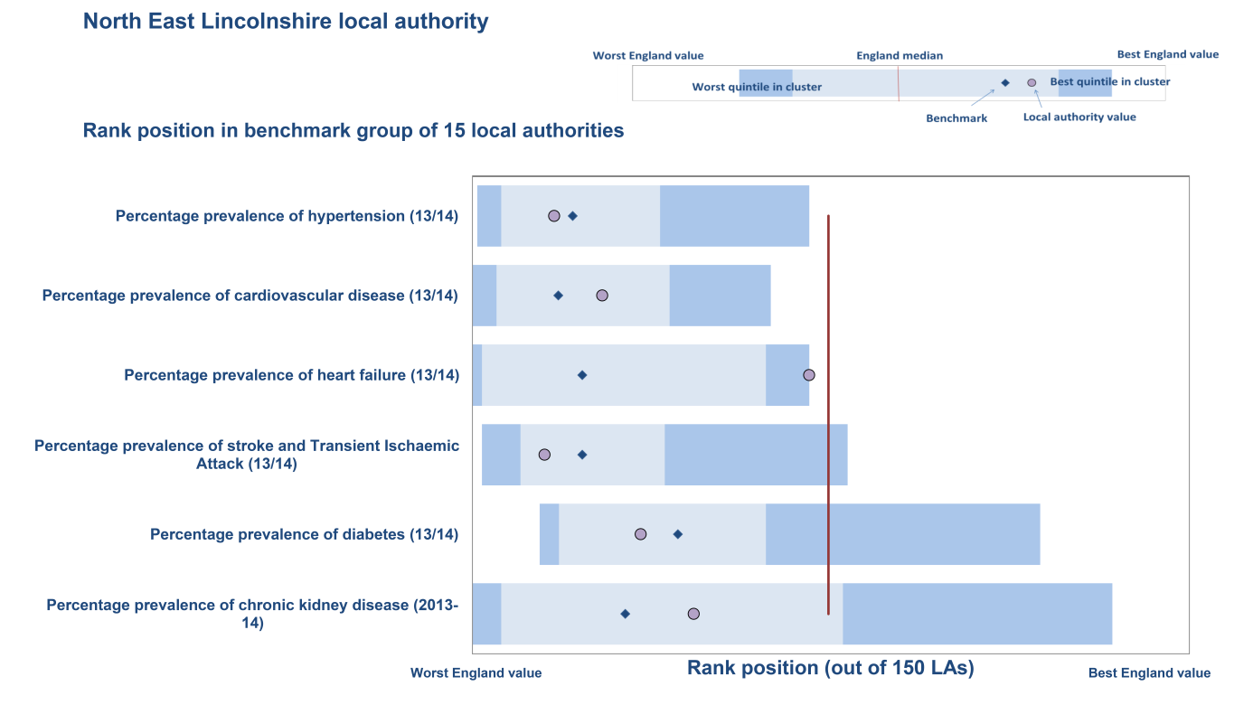
Issues affecting older life
People are now living much longer and the body at 55 is very different to the body at 75. Long term conditions
It is predicted that 29.3% of older people who have a long term illness which affects their day to day activities a little (POPPI, 2015)
Source: Public Health England, North East Lincolnshire Ageing Well Pack

Slide 11
Issues affecting older life
Confusion and Dementia
1486 people in North East Lincolnshire diagnosed with Dementia, with 96.2% being aged 65+
Frailty
Affects up to 50% of people aged 80 and over
Five main pillars of frailty; falls, immobility, delirium, incontinence and susceptibility to the side effects of medication
Functional decline in day to day activities in those with multi morbidity or frailty is considerable and this can occur gradually or suddenly due to a fall or illness.
Our survey found... two fifths of older people reported that they had a significant health need. Just under three quarters reported that they take prescription medication at least daily.

Slide 12
Lifestyle behaviours
Lifestyle and behaviours can impact upon the health of older people and vice versa.
Physical activity
11% of men and 7% women aged 85+ are achieving the recommended levels of physical activity (Health Survey for England, 2012).
Smoking
In 2014, 11% of over 60s in England are regular smokers (ASH)
Alcohol
50 emergency admissions in NEL for alcohol related liver disease in people aged 60 and over.
Diet and nutrition
Our survey found... nearly half of over 60s have an alcoholic drink once a week or more, with 11.8% drinking almost daily.
Our survey found... under half (48.8%) of respondents reported eating three meals a day.

Slide 13
Age Friendly Place – Wider determinants that can affect the health of the elderly
Place has a major impact on the health and wellbeing of older people
The World Health Organisation (WHO) has launched an age friendly checklist to encourages places to be age friendly.
Outdoor spaces and buildings
Transport
Housing
Social participation
Respect and social inclusion
Civic participation and employment
Communication and Information
Community and health services

Slide 14
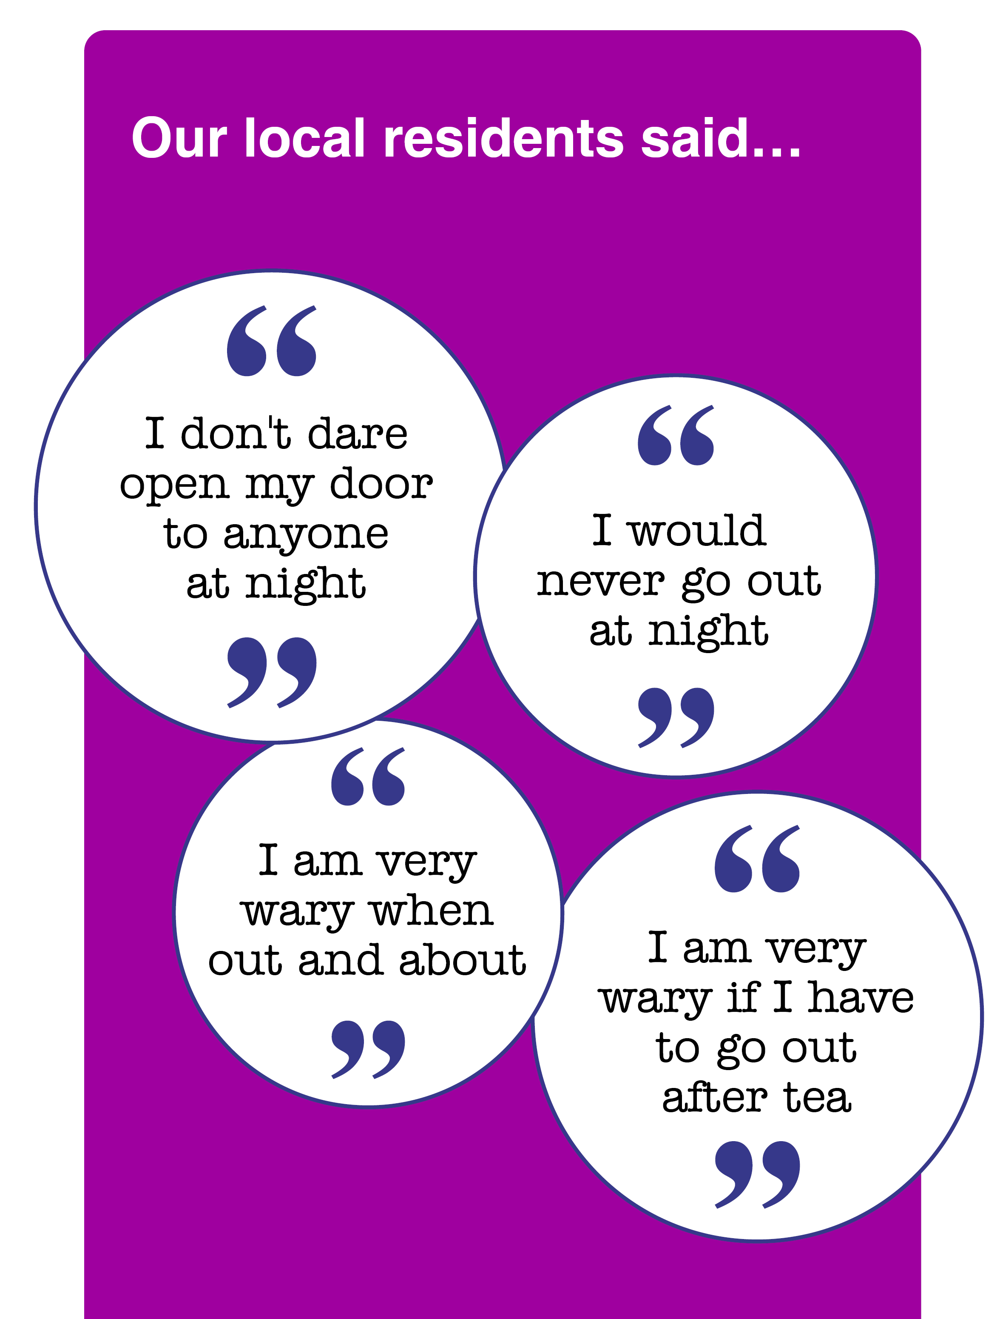
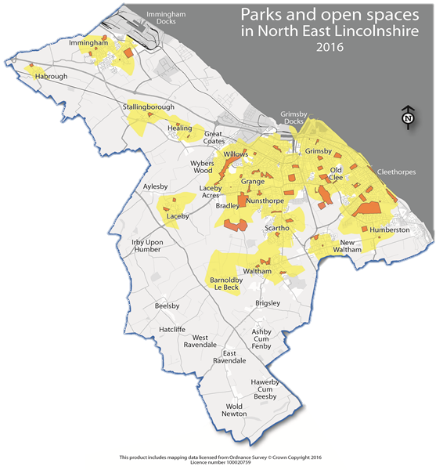
Age Friendly Place - Outdoor spaces and buildings
WHO recognises that outdoor spaces and safety of the area can impact upon the quality of life of older people, and can impact on their independence.
94.2% of NEL population is living in an urban environment, despite this there are many open spaces and parks within the area

Slide 15
Age Friendly Place – Transport
Despite NEL being predominately urban with centres of Grimsby, Cleethorpes and Immingham, there are areas with rural communities. Despite most having good transport links there are some rural residents unable to access mainstream public transport.
Our survey found...
Most people find it easy to get out and about to do various activities including shopping, health care and for social activities.
Most reported that they regularly drive themselves.

Slide 16
Age Friendly Place – Housing
A priority in the local plan is to increase the provision of housing and ensure it is appropriate for older people.
A 60 unit Extra Care Housing (ECH) has been developed by NEL Council and CCG with plans for four further ECH within the area in coming years.
Our survey found... 96.5% of older people lived in either a house flat or bungalow, of which 91% owned their own home.
Poverty
12.5% of people in receipt of benefits are of pensionable age
Fuel Poverty
The depth of fuel poverty increases in older households rather than the proportion
Can affect both physical and mental health particularly within
vulnerable groups such as the elderly

Slide 17
Age Friendly Place – Social participation, respect and social isolation
The number of older people living alone is set to rise which may impact upon social isolation
Good neighbours project

Slide 18
Age Friendly Place - Civic participation
Volunteering
In NEL there are various training opportunities to equip older people with the ability to volunteer and provide older people led services in the community.
k
Employment
In NEL there are various training opportunities to equip older people with the ability to volunteer and provide older people led services in the community.
;
Training/ learning
Furthering education should not be discouraged because of someone's age and older people may use this as a social opportunity.
Our survey found... 44.2% of respondents had given unpaid voluntary help to a group, club or organisation.
Our survey found... 31.7% reported that they had been in paid work over the last year.
Our survey found... in the past year 12.7% had attended an adult learning class.

Slide 19
Age Friendly Place – Community and Health Services
Local health and care services face significant challenge due to the increasing population, particularly in elderly who are often more in need of local services.
Healthy lives Healthy Futures
A long term programme between North East and North Lincolnshire CCG’s aims to investigate how an improved health care system can be developed across Northern Lincolnshire.
Residential Care
3rd lowest rate in the Y&H region for older people (65+) who were admitted to residential or nursing care homes in order to support their needs (553 per 100,000).

Slide 20
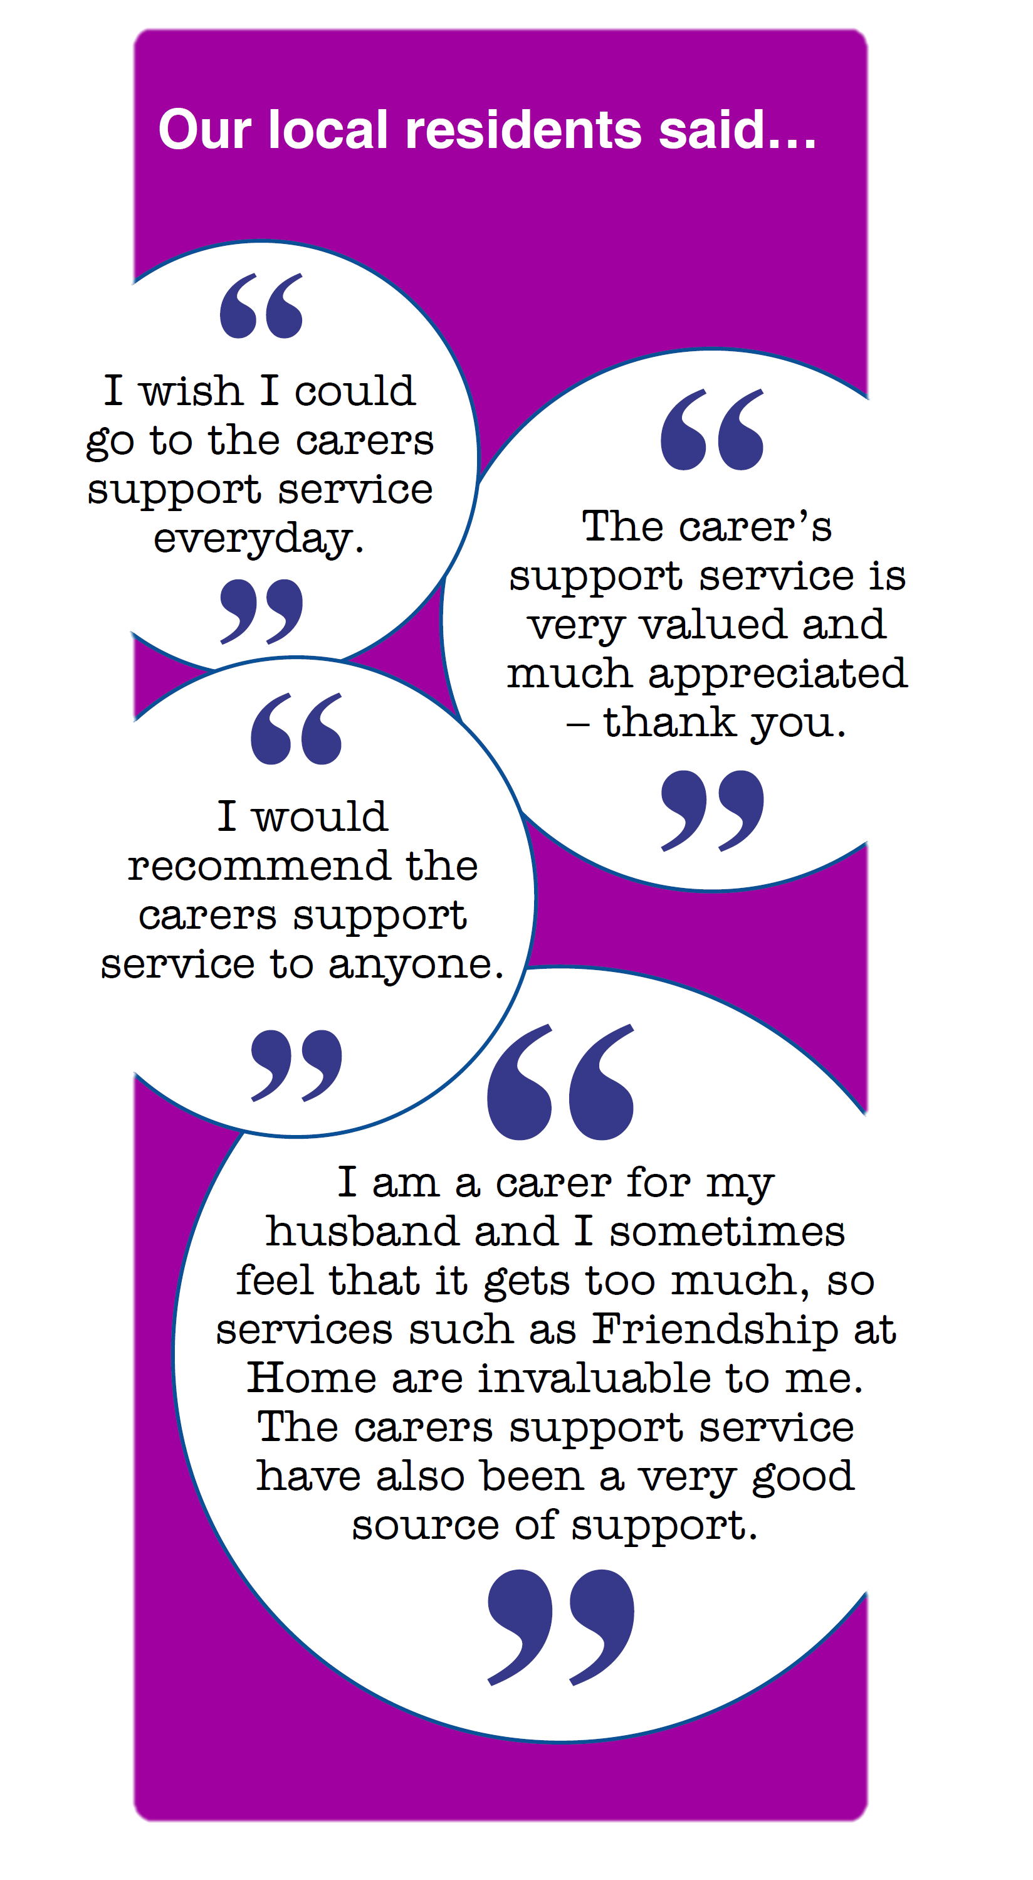
Age Friendly Place – Community and Health Services
Older People as Carers
the 2011 census identified that there were 3820 unpaid carers in North East Lincolnshire aged 65 and over
In 2014/15 88.3% of carers received self-directed support (greater than England and Y&H)
Our survey found... 17.5% of over 60s
reported that they were carers, with a
quarter caring for someone for over 50
hours per week.

Slide 21
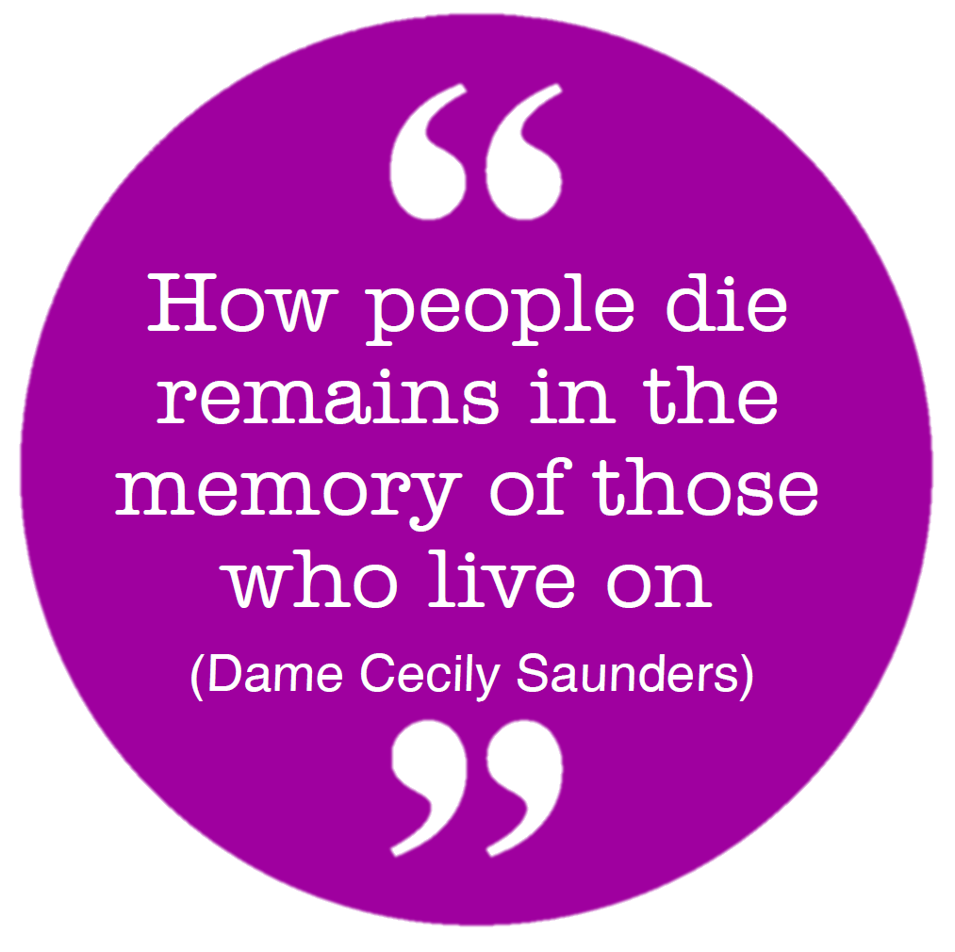
End of Life Care
Refers to people who are “approaching the
end of life” within the next 12 months.
Deprivation is a major determinant of end
of life care, and therefore where, when and how
people die.
Cost of dying is increasing nationally
In 2014 the cost of dying had increased almost 40% since 2007 (Sunlife, 2015).
In North east Lincolnshire from an online survey in 2015:
66% had paid in excess of £3000
86% thought the cost of funerals were too high
Our survey found...
78% had made a will
Half had discussed funeral type they would like
27% had appointed a lasting Power of Attorney

Slide 22
End of Life Care
Most people prefer to die at home and without warning, however this often does not happen. In North East Lincolnshire nearly half of deaths in people aged 60 and over are in hospital.
Source: Primary Care Mortality Database

Slide 23
Recommendations
Consider targeting segments of population susceptible to frailty and offering “wellbeing check” in own home.
Investigate availability of local data for older people to inform the needs of the older population with a view to identifying gaps and health inequalities.
Encourage the development of an ageing charter by voluntary organisations reflecting the change in culture.
Improve communication and sharing of information at provider level to ensure that services work together more to provide a seamless service.
Using the WHO age-friendly checklist, conduct an audit to identify how age friendly North East Lincolnshire is as a place.
Continue to use and raise awareness of the “services4me” database and the use of the Single Point of Access.
Explore ways to obtain local data relating to social isolation and loneliness e.g. older people who have recently been bereaved.

Slide 24
Explore ways to identify older people who are at most risk of being lonely/socially isolated e.g. utilise appropriate “community connectors” (hairdresser, postman).
Encourage schools to provide opportunities for young people to learn about ageing and older people e.g. teaching compassion for older people, encouraging young and old to mix together more, teaching children about dementia etc.
Services to recognise the change in our culture and to challenge stereotypes of older people e.g. providing services older people want and not based on assumptions.
Continue to improve our understanding of the local levels of poverty in later life including funeral poverty.
Continue to support older people to have a dignified end of life in the location they choose.
Raise awareness of the importance of making preparations for end of life e.g. will writing, Power of Attorney etc.

