Slide 1
Commissioning / Contracting and Service Developments
Helen Kenyon
Deputy Chief Executive
September 2015

Slide 2
Highlights 2014 – 15
Over the last year there have been a number of notable highlights!
This presentation will provide an overview of some of these covering the following areas:
Children & Young People
Adults
Older People
Supporting Independence
Technology

Slide 3
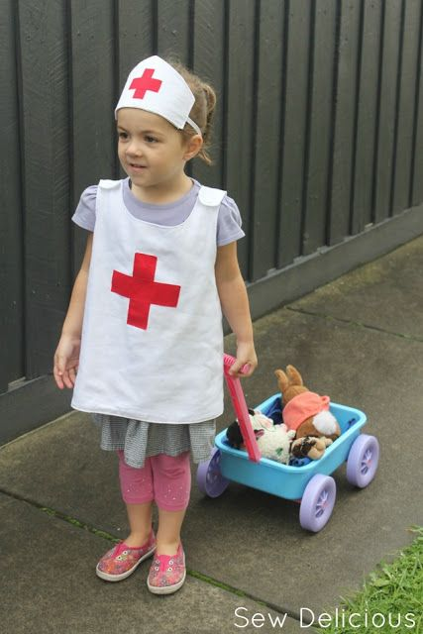
Children and Young People
Enhanced Children's Community Nursing Service:
Benefits include:
Nurse specialists in diabetes, respiratory, endocrine, diabetes, palliative & community paediatric consultant.
Phlebotomy clinics in 3-primary care centres.
Unnecessary outpatient appointments avoided.
Improvements in performance across a range of condition areas.
Model of good practice nationally. (Royal College)
Prevention, early intervention:
Achieved excellent immunisation rates which are amongst the highest (best) in the country.
Achieved timely health assessments for children who are looked after (LAC)
Continued success of paediatric assessment unit (PAU)

Slide 4
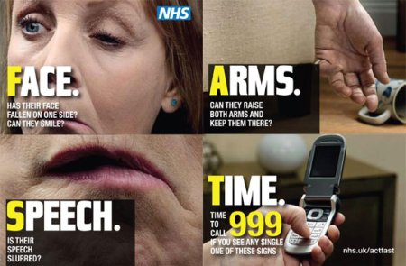
Adults:
Major Service Re-design of Stroke Services:
In Oct 14, permanent decision to consolidate hyperacute stroke services on the SGH site.
Centralisation has yielded many benefits:
Service is 24 hours a day, 7 days a week
The unit was rated one of the highest out of all 17 Y&H units
Enhanced thrombolysis access and treatment
Improved clinical knowledge and expertise
Diabetes:
a number of highlights including:
Spec for Community Diabetes Nurse Specialist
Enhanced insulin injection service
Patient guide and support group developed

Slide 5
Older People
Re-commisioning of Domiciliary care Services:
Led to a number of benefits in NEL such as:
Enhanced service specification
Robust service which will offer better quality outcomes for service users
A sustainable service for the life of the contract.
Care Home – Quality Framework (QF):
Now in its second year the scheme has been locally and nationally recognised because:
It drives continuous improvement in the sector.
it assesses individual homes against 14 quality standards
It effects change e.g. we have had a 50% increase in the number of nursing homes achieving silver.

Slide 6
Supporting Independence
Assisted Living Centre:
Opened June 2015
Advise, Information & Signposting on all aspects of independent living
Demonstration facility showing Aids for daily living
ALC
Assisted Living Centre
Supported living and Extra Care Housing:
Supported living for people with Learning and Physical disabilities at the willows
Strand Court Extra Care housing
Giving people an alternative to long term residential care, & their own front door

Slide 7
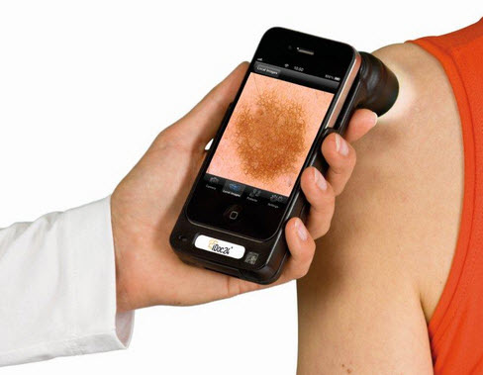
Use of Technology:
Investment within A&E in:
Radio Frequency Identification Devices (RFID’s) and
Inbound screens
These have significantly helped ambulance crews and the A&E department better manage appointments and patient flows
Investment in teledermatology has meant that …
People can now attend their local practice and potentially receive on-going care locally …
This is much more timely and efficient compared to having to travel for face-to-face consultations.

Slide 8
In summary 2014/15
Good progress made across a range of areas in 2014/15
Priorities for the future are:
Urgent and emergency care
Long term condition management
Planned care
Supporting independent living

