Slide 1
Primary Care Commissioning Committee 29th May 2018
GP Forward View Update
Julie Wilson, Assistant Director,
Rachel Singyard, Service Manager

Slide 2
International GP Recruitment
Current focus on Spain
Toledo Conference in March 2018
Barcelona Congress in May 2018 (153 delegates completed short form application)
Palma Congress in October 2018
Northern Lincolnshire ‘Taster Weekend’ for interested candidates 12th to 15th July
12th July – arrival and evening discussion with Health Education England and local Responsible Officer for Performer’s List
13th July – full day in Practice and evening informal buffet with practice reps and CCG reps
14th July – English language baseline test am and tour of area pm, with evening meal
15th July – travel home

Slide 3
International GP Recruitment
Process from interest to recruitment 12-18 months
English test (IELT or OET)
NHS England Induction and Refresher Scheme – will require time in training practice/under supervision of training practice
Issue locally is training support (as not all Practices taking part are training practices)
Non-training Practices to buddy up with training practices
10 NEL Practices initially expressed interest and 2 more since
Looking to recruit 10 GPs to the area through this scheme

Slide 4
Online Consultation
Secure, on-line consultation software that enables patients to use website to enter details of condition and request support from Practice at any time
STP-wide procurement end of 2017/18 – secured licences to cover 115,000 population within NEL
Developing rollout plan for 2018/19 (Practices asked to confirm commitment)
Consultation software is ‘Engage Consult’ (provided by Wiggly Amps)
Patient engagement when designing model within practice
The messages patients receive via the e-consultation can be tailored by individual practices depending on whether patients use Engage Consult to request help either within or out of surgery hours.

Slide 5
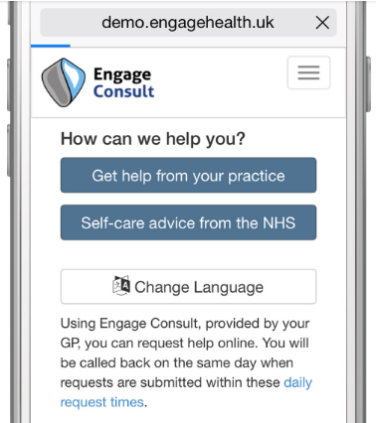
Online Consultation

Slide 6
Online Consultation
‘Statistics indicate that on average 30% of time is saved by using IMH to contact their GP first when compared with pre-booked face-to-face consultations. The efficiency gain comes from patients providing a structured history of their symptoms in their own time, not the GPs. The information gathered assists clinical decision-making for next steps: see patient, call with advice, refer or prescribe.’

Slide 7
Care Navigation
Care Navigation offers the patient ‘choice not triage’ to access the most appropriate service first which as we know, isn’t always the GP.
Care Navigators do not make clinical decisions

Slide 8
Care Navigation Initial event to identify services to navigate to: Community Pharmacy(minor ailments) Sexual Health Services – Virgin Care IAPT - NAViGO Pregnancy Advisory Service Live well – NELC wellbeing service

Slide 9
Care Navigation
Series of training events(Feb-April)
Clinical templates produced
Launched at April PTL event
119 “Care Navigators” now trained

Slide 10
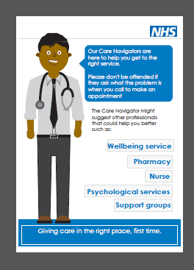
Care Navigation
Communications pack to practices
Reporting quarterly

