Slide 1
Northern Lincolnshire Healthy Lives Healthy Futures Programme
NELCCG Board Update
March 2015

Slide 2
Clinical Service Planning Framework Shows 4 key clinical workstreams and inter-relation with vision for HLHF and key enablers
Area of clinical focus
Planned
Care
Unplanned
Care
Long Term Conditions
Maternity
Workforce
Diagnostics
Therapies
Technology
Comms/Engagement
Estates
Contracting/Finance
Fully engaged public and patients

Slide 3
Leads for Clinical Workstreams
Unplanned Care
Oltunde Ashaolu, AMD for Medicine, NLaG
Fergus Macmillan, NLCCG GP
Rakesh Pathak, NELCCG GP
Planned Care
Susan Levison-Keating, Consultant Haematologist, NLaG
Gary Armstrong, NLCCG GP
Helen Buckley, NELCCG GP
Long Term Conditions
Dr Nick Stewart, NLCCG GP
Susan Levison-Keating, Consultant Haematologist, NLaG
Dr Arun Nayyar, NELCCG GP
Maternity
Lawrence Roberts, AMD Women and Children, NLaG
Dr Margaret Sanderson, NLCCG GP
Dr Marcia Pathak, NELCCG GP

Slide 4
Clinical Groups
Each of the clinical groups have been asked to provide:
A set of key clinical principles that describe and enable how they want to deliver services into the future
Broad agreement on a clinical model for the service area (for refinement post March 2015)
A high level description of phasing of work required

Slide 5
Example Output - Key Principles of LTC model
Pro-active, Preventative services
A model that defines what should be delivered in hospital and out of hospital
Core MDT teams are based around practice collaboration, not organisational boundaries
Secondary care clinicians are available for support and education
Communication is key “a better conversation”
Patients are empowered to access care when they need it – patients need to be able to speak to the right person at the right time without having to jump through organisational hoops
Emphasis on supported self management, maintaining independence.
IT solutions that support integration of care
Requires a fundamentally different approach to commissioning – focus needs to be on outcomes, not activity. Commission patient pathways so patients are seen by the most appropriate professional/service to meet their needs.

Slide 6
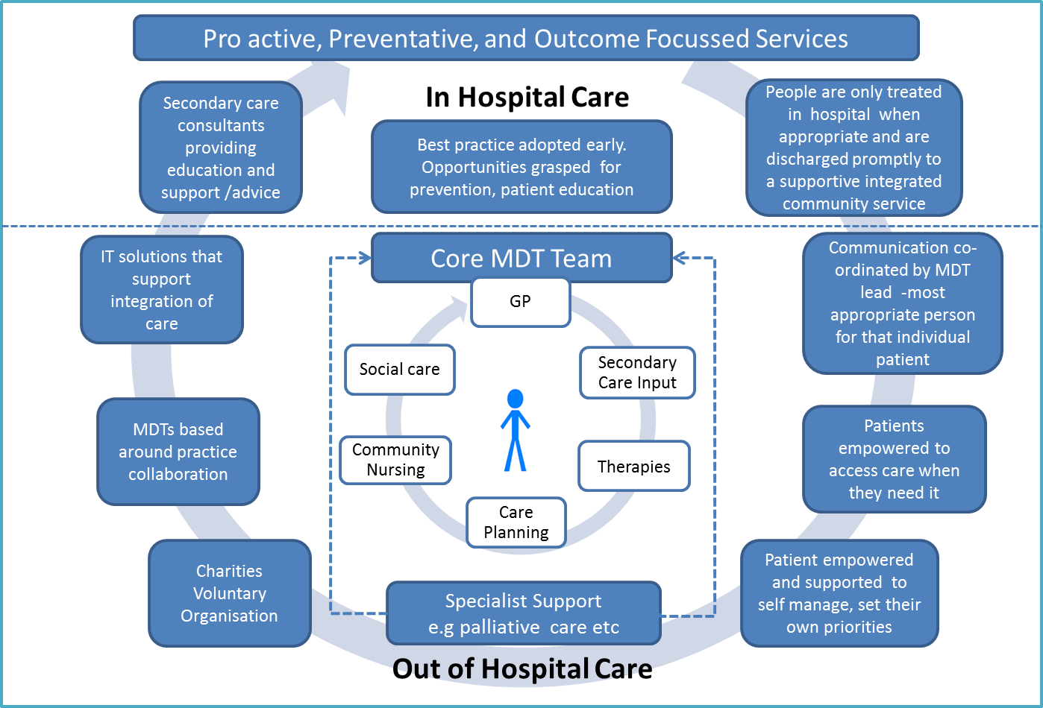
Example Output – Long Term Conditions

Slide 7
Northern Lincolnshire Healthy Lives Healthy Futures Programme
Reporting
March 2015

Slide 8
Monthly Programme Report
Key accomplishments since last report | Upcoming Key Activities (for next reporting period)
Clinical working groups met Accountable Officer arrangements until March 2016 confirmed Independent chair of assurance group confirmed Programme reporting arrangements refined and weekly reporting in place via SSPG Local modelling leads identified to link with PWC when model is at an appropriate stage QIA process agreed Community Finance plan further refined via sub group Clarification around Marketing, Comms and Engagement – membership of group refined and draft C+E plan developed | Development of clinical model, as defined by clinical working groups to feed HLHF strategy Further clinical engagement on HLHF to take place within NLaG and clinical model to support provider service redesign work Community finance plan signed off Handover of finance and activity -model to local teams Marketing, Engagement and Communications plan signed off Key stakeholders (OSC etc) informed of HLHF progress and plans for next stage HLHF narrative strategy developed and signed off

Slide 9
Scheme Tracker
The key clinical workstreams will each have a number of specific schemes
Project progress is monitored against key dates via the HLHF scheme tracker
The tracker relates to areas identified on the A3’s (For assurance around the development of projects)
Reporting to the weekly HLHF operational group is by exception/red RAG rated elements only
Locality programme leads/PMO will liaise with project leads to obtain initial A3’s and then relevant dates on red RAG rated elements
PMO will contact project leads for updates the week prior to key dates or if the date has passed and no update has been given

Slide 10
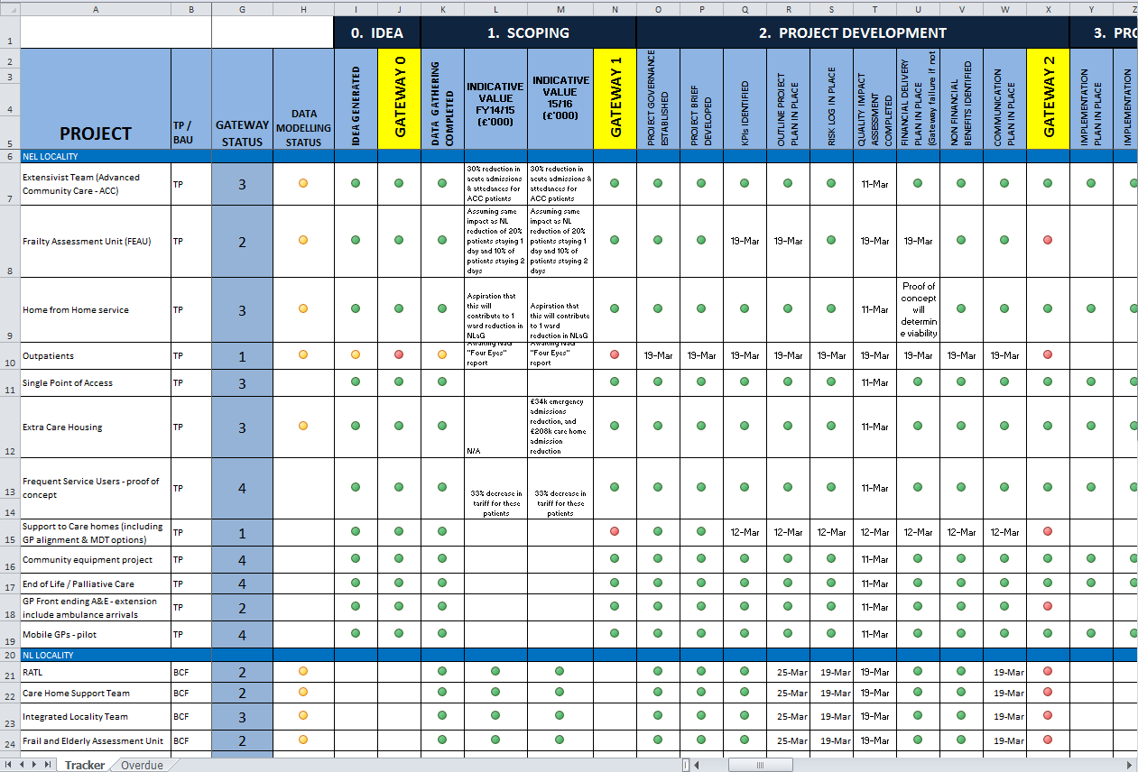
HLHF Scheme Tracker This slide shows the current state of all projects in NEL, all other schemes available on full tracker

Slide 11
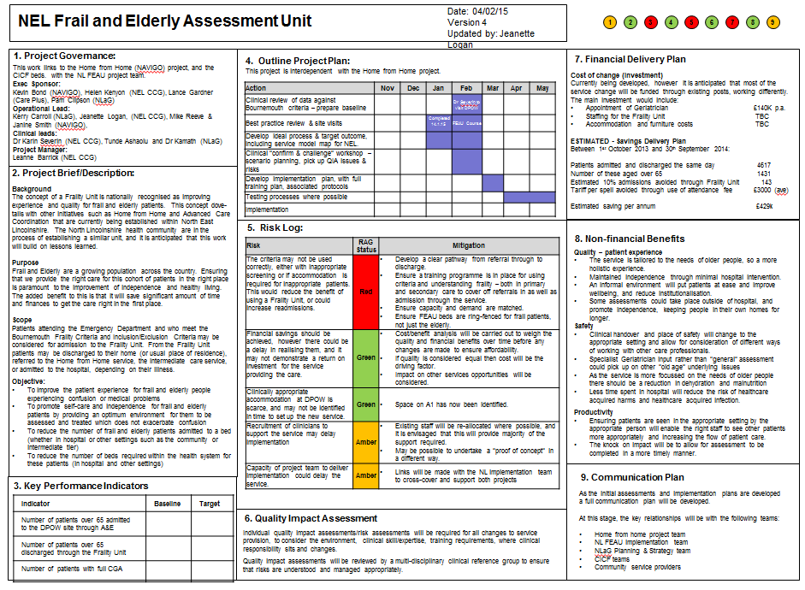
Project Plans
Each project will have a completed plan on a page to assure state of readiness and to support it’s tracking and monitoring, the below is for example purposes

