Slide 1
NEL Emergency Planning and Resilience Group
6th November 2020

Slide 2
Agenda, please bring a cuppa ☺
General introductions
Winter & General Resilience
Covid-19 Update
EU Exit Update
EPRR Assurance Update
Training
AOB/Other risks to raise

Slide 3
Winter & General Resilience
Development of HCE requested North East Lincolnshire Business Continuity Plan summarising very generally BCP arrangements across the system and interdependencies. Most up to date copy circulated with the minutes
Winter reporting has now been stood up from 2nd November. Daily system calls reinstated. Majority of organisations reporting on RAIDR with a view to removing old Daily Pressures Report.
Northern Lincolnshire Winter plan being discussed at Delivery Boards.
Main focus from an emergency planning perspective outside of system should be isolation capacity in care homes and acute trust.

Slide 4
Covid-19 update
General pressures across the system now.
Primary care seeing more staffing pressures due to positive cases (small number) and community contacts.
12 care homes presently with outbreaks as of 15:00 4th November.
3 outbreaks at NLaG but all wards involved now re-opened.
1 new outbreak at HMT St Hughs
1 new outbreak at NAVIGO Harrison House
1 new outbreak within NAVIGO Extra
1 new outbreak in supported living setting

Slide 5
Covid-19: Planning
NEL Outbreak Management SOP circulated with the minutes signposting and simplifying process for plethora of local health and care settings.
Primary Care webinar held 4th November to discuss process for positive causes and outbreaks.
Directors of Public health presently drafting mass treatment plans.

Slide 6
EU Exit
Keith Willet webinar held 4th November 2020 with multiple guest speakers. “Version” of slides to be released.
Much of the requested preparation is the same as before.
November assurance ask is expected, with similar questions to those asked previously.
Key points:
Negotiations continue but NHS being told to prepare for “default outcome”
Guidance will be coming out in the next few weeks
Revisit the Operational Guidance Requirements.
Don’t create new plans “just for Brexit”. Rely on existing plans for shortages in supply and workforce – review and ensure they are fit for purpose
Reporting will be aligned with Covid-19 and winter reporting using existing mechanisms. EUX SITREP “stitched in” to other reporting. For this reason ensure the workforce/team dealing with all of this is well resourced and resilient.
Existing routes of escalation to be utilised e.g. NSDR.
Revisit existing EPRR plans and BCP’s. CCG to review assurance exercises and “asks” already conducted.
Ensure you have route for keeping your Board aware of issues
“Walk the floor” – what would you do if……

Slide 7
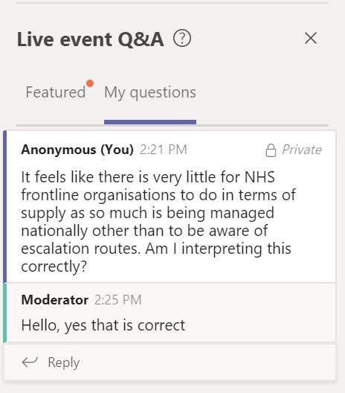
EU Exit - supply
A lot of this work is being managed nationally.
List of “main suppliers” contacted released (circulated with slides)
6 week buffer to be maintained on medicines and fast moving consumables.
NSDR to remain for emergency escalation issues
No stockpiling, no long prescriptions
Follow BAU processes
National continuing to secure air freight for short shelf life medications and RoRo capacity for alternative freight routes
Working well with port providers.
Local systems should ensure they work together on shortages of vaccines – Emergency Planners should engage with Pharmacists where possible.

Slide 8
EU Exit – other areas
Blood & transplant – treat as normal, comms being developed to promote blood donation
Continue to recruit to clinical trials
NHS E developing resources to support staff to “myth bust” on validity of qualifications, continuation of contracts etc.
Data – identify flows and storage. Ensure compliance with GDPR
ASC – same messages as before. CCG to review recent “asks” on BCP and last year’s assurance piece to identify gaps
Primary care – understand your escalation routes, prescribe and dispense as normal, ensure you are signed up to CAS alerts, register patients as normal (some changes may come on eligibility of care) – promote electronic repeat dispensing.

Slide 9
Last bits to mention
MHRA takes on responsibilities for certifying medical devices that are currently undertaken through EU System from 1st Jan 2021
CE marking will continue to be recognised in Great Britain until 30 June 2023
Certificates issued by EU-recognised Notified Bodies will continue to be valid for the Great Britain market until 30 June 2023
After the transition period, the EU will no longer recognise UK Notified Bodies
From January 2021, all medical devices placed on the UK market will need to be registered with MHRA

Slide 10
RWCS EU Exit September 2020
Third country controls imposed. All freight without correct documentation will be stopped before boarding services in the UK.
40-70% of trucks travelling to the EU might not be ready for new border controls.
Short channel crossings via Dover and Eurotunnel 30-50% of trucks might not be border ready. Could reduce flow rate to 60-80% of normal levels.
Max queues of 7,000 port bound trucks in Kent and max delays of 2 days.
Lower disruption initially but will worsen over the first 2 weeks.
Could be significant drop in disruption and improvement in flow within 3 months.
Winter spike in Covid could suppress freight demand and limit the traffic disruption, but absenteeism among port or border staff could impact fluidity.
Reasonable Worst Case Scenario for borders at the end of the transition period on 31 December 2020

Slide 11
EU Exit - Useful links
Useful links The following links to useful guidance: Contact the relevant team at the Department at:
Medicines contingency team: medicinescontingencyplanning@dhsc.gov.uk.
MDCC contingency team: mdcc-contingencyplanning@dhsc.gov.uk.
Clinical Trials: ctcontingencyplanning@dhsc.gov.uk.
Vaccines and Countermeasures: Immunisation-MB@dhsc.gov.uk.
Blood and Transplants: transplants@dhsc.gov.uk.
Non-Clinical Goods and Services: contractreview@dhsc.gov.uk.
EU Settlement Scheme: local authorities toolkit
Page summary This toolkit equips you with the right materials and information to support EU citizens to apply to stay in the UK

Slide 12
EPRR Assurance Update
Slightly scaled down process for this year
Statement required signed off by AEO to confirm progress made on non or partially compliant areas from last year
NELCCG – Substantially Compliant – more work required on infectious disease
NLAG – Substantially Compliant – more work required on CBRN training
CPG – Substantially Compliant – link in with CCG on infectious disease planning and pandemic flu to formulate internal documents
NAVIGO – Partially Compliant – work required on Senior Manager training, lockdown procedures, loggists, and BCMS audit.

Slide 13
Training
Covid-19 response can be used as Live Ex and Command Post
Variety of tabletops have run throughout the year led by the LRF, DPH’s, NELC, NLaG and NHS England.
Ensure comms tests are completed and contact details are up to date.
NHS England course developed to replace SLIAC - EPRR (NHS) Command and Control Development Programme
£150 pp – contact Paul Leach - paul.leach@nhs.net
Clandestine Workshop minutes circulated – to reconvene end of Nov.

Slide 14
AOB/Risks

