Slide 1
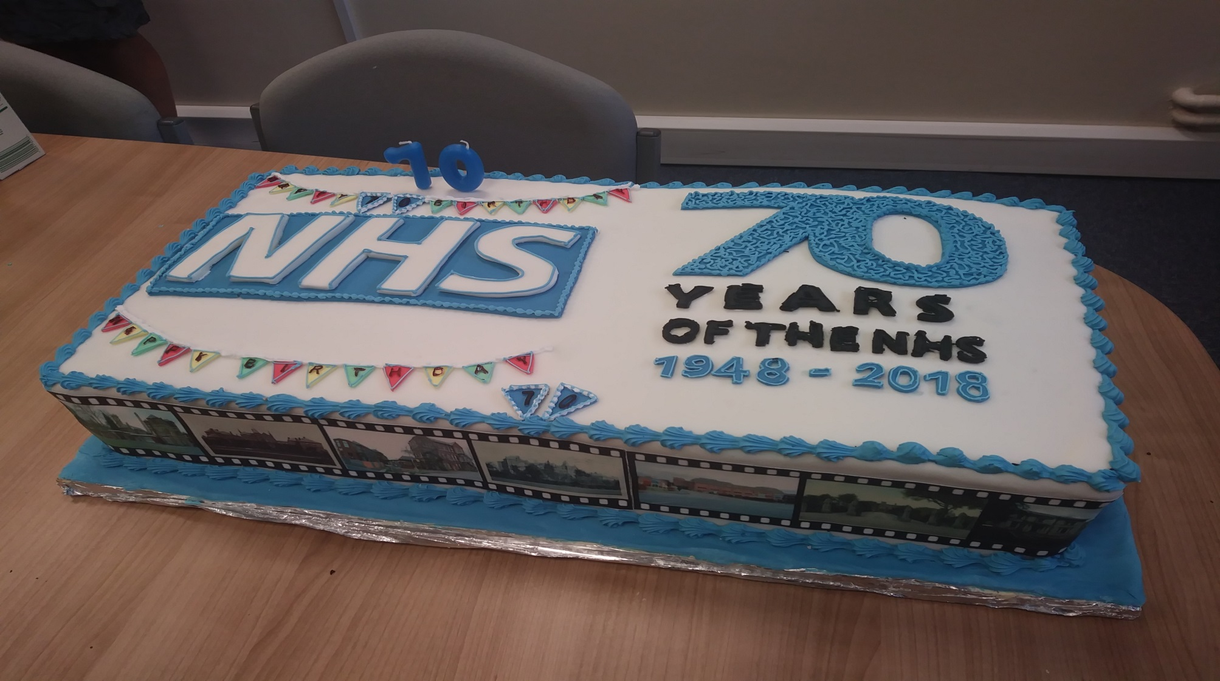

Slide 2
External Assurance
Assessed as ‘Good’ under the CCG Improvement & Assessment Framework, which covers the following 4 domains:-
Notes:
North East Lincolnshire CCG is assessed against the Improvement and Assessment Framework (IAF) which consists of 4 domains: Better Health, Better Care, Sustainability, and Leadership. CCGs are assessed against these domains by NHS England (NHSE) in quarterly and year-end, face-to-face meetings. North East Lincolnshire CCG’s performance is published on My NHS and updated quarterly.

Slide 3
External Assurance
Clinical Priorities
Cancer – Inadequate (2017/18)
Dementia – Outstanding (2016/17)
Learning Disabilities – Requires Improvement (2015/16)
Diabetes – Outstanding (2016/17)
Maternity – Rated as Requires Improvement (2017/18)
Mental Health – Good (2016/17)
Notes:
Dementia and Diabetes - NELCCG is rated as ‘Outstanding’ and amongst the top performing CCG’s in the country.
Mental Health - NELCCG was rated as ‘Good’ which is similar to over a third of other CCGs in the country. (It should be noted approximately half the CCGs are in the ‘Requires Improvement or Inadequate rating). However despite performing well the CGG is focusing on improving performance on rates of recovery for people accessing psychological therapies.
LD & Maternity - NELCCG is rated as ‘needs improvement’ . However when compared nationally the majority of other CCGs are rated the same in these areas too.
Cancer - NELCCG is rated as ‘Inadequate’, when compared nationally half the other CCGs are rated as ‘Requires Improvement’ or ‘Inadequate’.

Slide 4
Quality – 2017/2018.
Safety – triangulation of CCG intelligence, listening and responding to concerns raised across the System (NITS), focus on clinical harm from excessive waiting and infection prevention and control.
Effectiveness – mortality and Learning Disabilities Mortality Reviews (LeDeR) to improve clinical care, assurance visits to seek assurances, working with Humber CCGs to align clinical policies, changes to our CCG Quality Committee.
Positive experience – patient stories & engaging with the community through Accord to hear peoples experience of services,

Slide 5
Quality in 2018/2019.
Continue to improve our systems & processes, data and reporting in respect of the 3 areas of quality and clinical governance, and working closer on this with the council
Challenging targets in respect of infection prevention & control
Focus on areas of concern.
Leading developments with all providers to improve quality and focus on professional nursing issues.

Slide 6
Financial Performance - 2017/18
All statutory financial duties achieved.
Delivered surplus of £8.1m, as required by NHS England.
Delivered a break-even position on Adult Social Care
Managed cash within notified Cash Limit.
Delivered Running Costs expenditure within target.
Paid 95% of supplier invoices within target.
Delivered savings across Health & Social Care of £6.1m in the financial year .
Unqualified external audit opinion ; financial statements, regularity & value for money.

Slide 7
How was the £267.9m spent.

Slide 8
In 2017/18 NEL CCG commissioned:-
30,485 planned admitted spells averaging £657 each
14,763 emergency spells averaging £2,139 each
191,885 outpatient attendances averaging £111 each
57,057 A&E attendances averaging £120 each
5,778 critical care days averaging £ 683 each
860 people supported in residential & nursing care averaging £566 per week
1,637 people supported with domiciliary care packages averaging £161 each

Slide 9
Performance – Notable successes
Delayed Transfers of Care 18% reduction year on year (3,560 days 2016/17 vs 2,909 days 2017/18).
Adult and older clients receiving a review 87.1% (1,346 of 1,546 people).
Proportion of adults 18+ (95.6% 1,237 of 1,294 people) and Carers (98.1% 365 of 372 people) who receive self-directed support both achieved target.
Adult Social Care
Permanent admissions 18-64 (13) & 65+ (203) to residential & nursing care both achieved target.

Slide 10
Performance – Notable successes
Estimated diagnosis rate for people with dementia – 71.2% (1,482 of 2,081 people) against target of 66.7%
IAPT access achieved Q4 target (4.3% 785 of 18,340 people).
IAPT 6 week (94.1% 1,530 of 1,625 people) & 18 week (99.4% 1,615 of 1,625 people) Waiting Times targets achieved.
Mental Health
Proportion on CPA discharged from inpatient care who are followed up within 7 days achieved target (98.5% 194 of 197 people).

Slide 11
Performance – Notable successes
Cancer
Prescribing
All 2 week and 31 day waiting times achieved their targets.
Sustained Reduction in antibiotics (4% from 15/16 baseline) and broad spectrum antibiotics (22% from 15/16 baseline) prescribed in primary care achieved.

Slide 12
Performance – Challenging targets
Mental Health
Cancer
IAPT Recovery rate – 47.5% against national target of 50% (745 of 1,570 people).
62 day (GP Referral) – 72.1% against national target of 85% (356 of 494 people).

Slide 13
Performance – Challenging targets
A&E Waiting Times
Consultant-led referral to treatment waiting times
NLaG Total time in A&E: four hours or less was 85.7% against national target 95% (128,775 of 150,337 people)
No waits from decision to admit to admission over 12 hours – DPoW 18, Target zero.
Incomplete Patients: % Seen Within 18 Weeks – 71.5% at March 2018 against national target of 92% (9,074 of 12,697 people).
52 week waiters – 81 at March 2018 against target of zero.

Slide 14
2018-19 Planning
Consultant-led referral to treatment waiting times
Cancer
Ensure all eight waiting time standards for cancer are met, including the 62 day referral-to-treatment cancer standard
A&E Waiting Times
Priority to stabilise all lists
Aspiration to eliminate 52 week waiters but current plan meets planning requirements to half them
Focus on long waiters
A&E – 3% month on month improvement compared to 17-18
Achieves the requirement of 90% for September

Slide 15
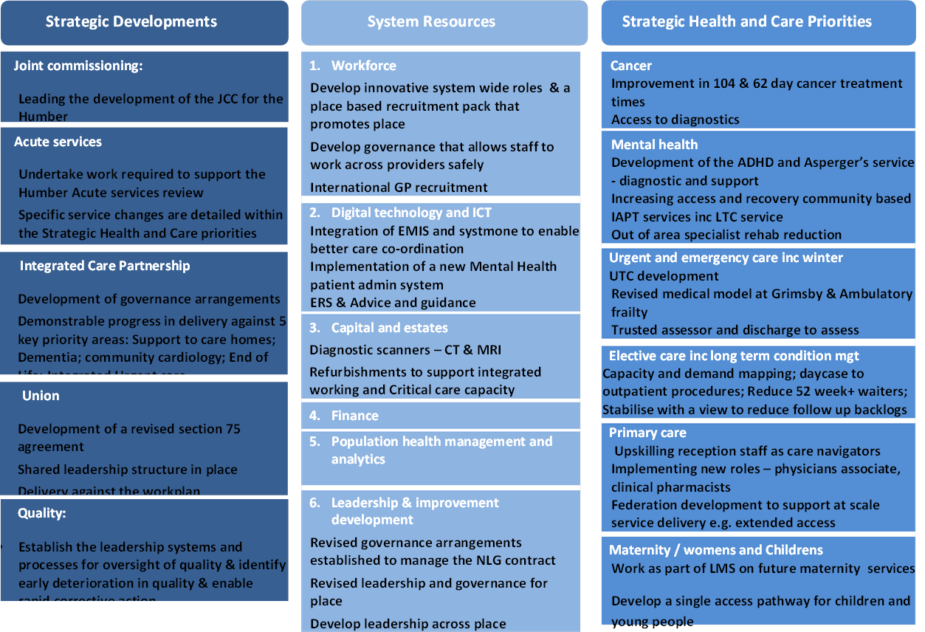
2018-19 Place Based Plan

