Slide 1
Primary Care Commissioning Committee 28th May 2019
Primary Care Strategy:
General Practice Transformation and Initiatives Update

Slide 2
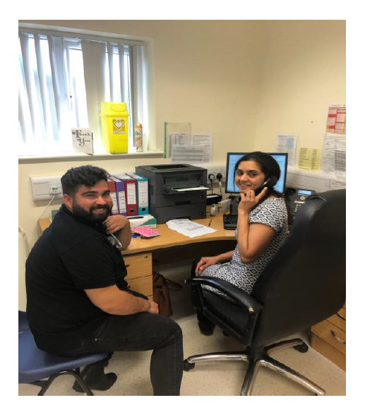
International GP Recruitment
Northern Lincolnshire CCG Taster weekend - 8th-10th March 2019
8 GPs attended from Spain
Of the 8 candidates who visited the recent weekend, all remain engaged with the programme, 2 are now accessing language and clinical support sessions with a further 4 planning to access language support a little later in the year
3 GPs spent a day in NEL Practices

Slide 3
International GP Recruitment
Evaluation points from weekend:
How committed are you to coming to work in North and North East Lincolnshire?
66% (4) reported ‘very likely’
33% (2) reported ‘likely’
Thinking about the IGP you hosted, would you offer them employment providing you had a vacancy at the time they are ready to come to the UK?
5 of the 7 the practices who responded stated they would offer their host candidate employment in the practice.

Slide 4
Online Consultations
7 SystmOne practices live (equates to 59,173 of the patient population)
9 practices scheduled to launch in May/June and the remaining 5 SystmOne practices committed to launch by September 2019 (equates to a further 71,348 of the patient population)
77% coverage of the population by September 2019
CCG will launch a promotional campaign to publicise widely to patients in September 2019.

Slide 5
Online Consultation
CCG working with STP on introducing a clinical code in SystmOne to link incoming consultations to episodes of care, with a view to measuring the impact
Currently Pilot with one practice and local care home
Other practices recognised the benefit of care homes using the system. Care homes - next phase of engagement.

Slide 6
Care Navigation
121“Care Navigators” now trained.
Latest training event – 16th May 2019.
Attended by new providers added – Social Prescribing, Carers, MSK service
Looking to offer face to face in practice support from June

Slide 7
Care Navigation
10,739 signposts recorded by 24 practices - notable increase of activity month on month.
99% of those signposts have been accepted by patients.
Monday and Wednesday are the busiest days for signposting.
89% of signposting is to internal practice services.
Top 4 services navigated to:
Nurse
HCA
ANP (advanced Nurse Practitioner)
Community Pharmacist
The split across age groups and gender shows highest signposts at ages 65-74yrs and 55-64

Slide 8
Care Navigation Signposts split by alternative to GP (exc. nurse triage)

Slide 9
Care Navigation
Impacts noted by practices:
Saves admin time
GP appointments saved for more complex patients (lower waiting times for appointments)
Feeling more knowledgeable about local services
Takes pressure off the reception/admin staff
988 estimated GP hours saved

Slide 10
Correspondence Management
Refresher training for:
Administrators – April-June 2019
Team Leaders - July 2019
In-practice implementation support session by the training provider
12 practices have already signed up to take advantage of this.
Survey in development to measure impact on GP time

Slide 11
Apex Insights tool
Tool will help support capacity and demand and workforce planning.
NHSE advised pause to the roll out as at 16th May
Further updated awaited – due end May 2019

